Slide 1
Canadian Unemployment Rate Analysis
Group 2 – Cadeem, Rob, Andrea, Will

Slide 2
Agenda
Introduction of Statement
Target Audience
Data Summary
Data Preparation
Analysis Outcome
Conclusion
Limitations and Assumptions
Learnings and Takeaways

Slide 3
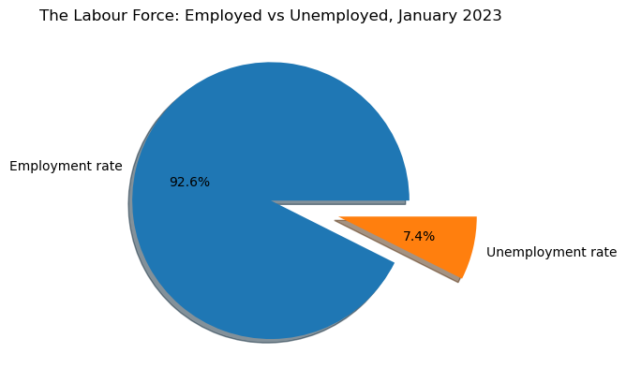
Introduction to Statement
What is the relationship between unemployment rate of Canada and economic and social metrics

Slide 4
Target Audience
Government agencies
Policy makers
Business leaders

Slide 5
Data Summary
Database | Date Range | Data Shape | No. of Columns | Data Information | Data Source
Unemployment | 1976 - 2023 | Table | 13 | Work force population Employment Unemployment Province | Statistics Canada
Household spending | 2010 – 2021 (excluding 2018, 2020) | Table | 16 | Average spending by categories Province | Statistics Canada
Immigration | 1971 - 2023 | Table | 17 | Type of migrant Age group Gender Province | Statistics Canada
Public transit | 2017 - 2024 | Table | 16 | Total transit revenue Total transit passengers | Statistics Canada

Slide 6
Data preparation
Data loading
Data cleaning
Merging datasets
Filtering datasets
Data reading

Slide 7
Immigration vs Unemployment Rate
Do unemployment rate affect immigration in Canada?

Slide 8
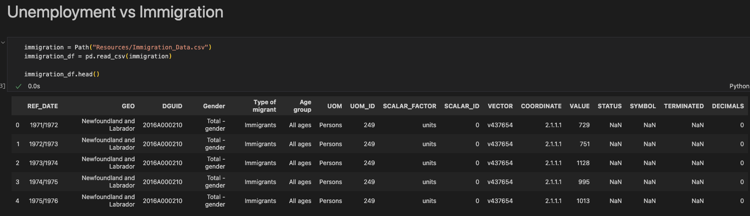
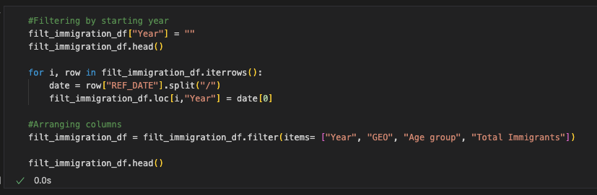
Data preparation

Slide 9
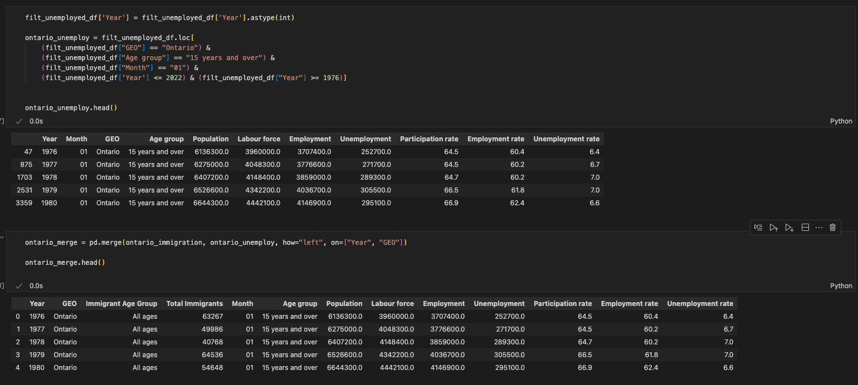
Data preparation

Slide 10
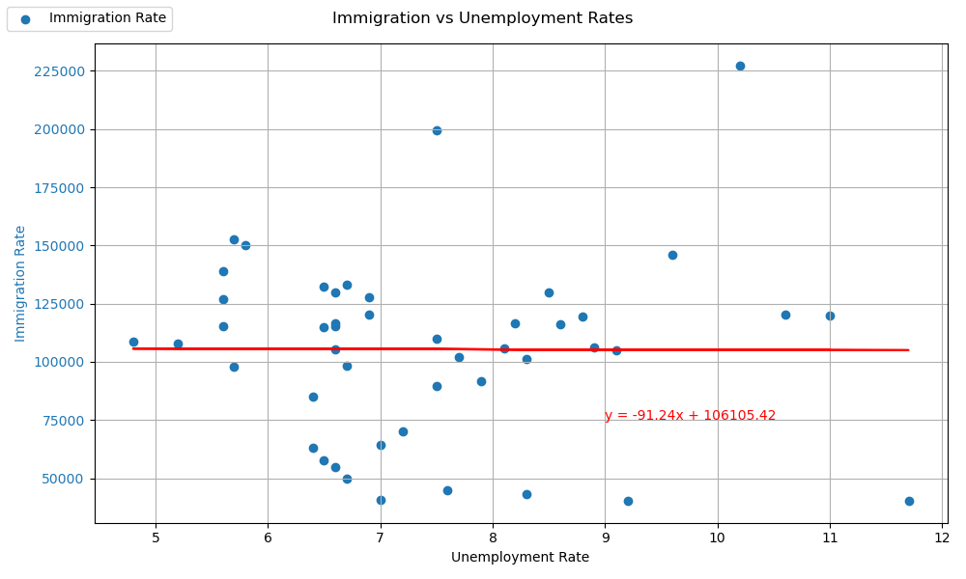
Analysis

Slide 11
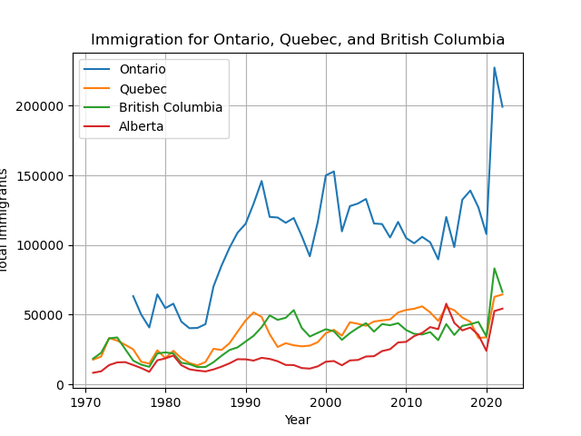
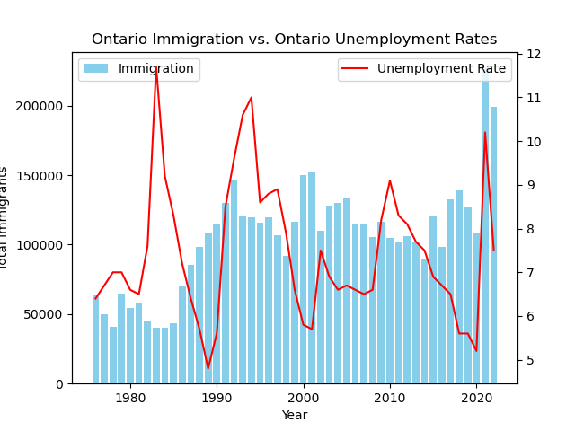
Analysis

Slide 12
Analysis

